Slide 1
Predicting Positive Returns for the student managed investment fund
Nicole Lind – Data Analytics 401

Slide 2
The Problem
Which features of a company best predict a positive stock return.
How do we quantify this data?
Does Phillip Fischer’s 15 points really produce positive returns?

Slide 3
Data Collection Phase
Created surveys and collected data from each stock expert
Input the survey responses into excel
Calculated the stock returns using historical data from Yahoo Finance

Slide 4
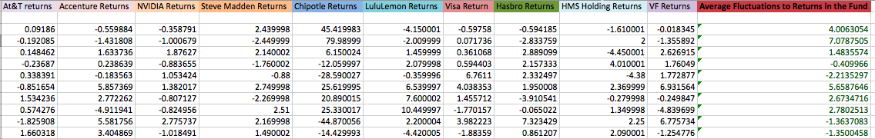
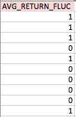

Slide 5
Transformation and Cleaning up Data
Make training set separate from validation set. Check to see if you need an imputer (missing values?)
One-hot encoding:
use Panda’s get_dummies method, which converts categorical variables into dummy variables and the cat_features method gives you a list of categorical features for the dataframe.
Remove response variable and create “features” variable for all other variables in dataset. Print statement to double check. Set response variable and explanatory variable.

Slide 6
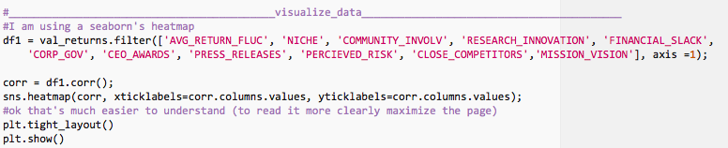
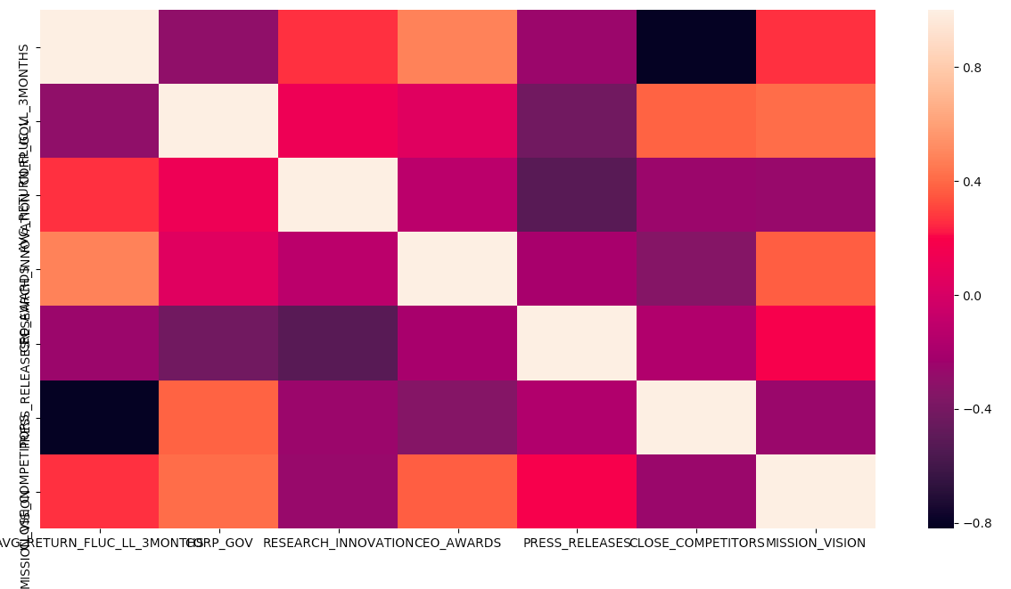
Data Visualization

Slide 7
Evaluating Different models
Support Vector Machine
Decision Tree Model
* Random Forest Classifier *
(With Model Ensemble)

Slide 8
Optimizing the Model
Note: Led to Over fitting
Grid Search
Voting Mechanism

Slide 9
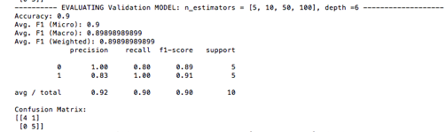
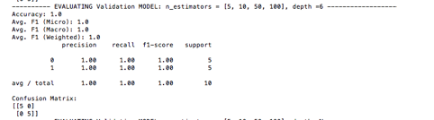
Validation (Without Optimization/With Optimization)

Slide 10
Conclusion:
Garbage in garbage out concept
Predictive validity was very high on random forest classifier
Too many rows, too few columns

